Slide 1
How Effective Are The Supplements I’m Taking? Request for Participants
David Greenwood, Hemavault
Quantified Self Meetup (March 2015)

Slide 2
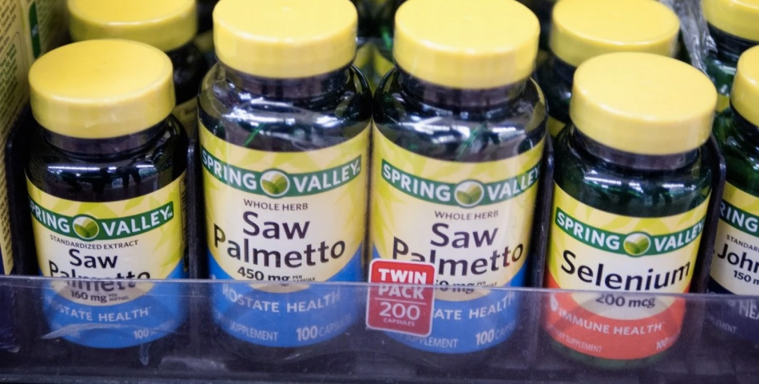
“Americans are ignoring the science and spending billions on dietary supplements”
Washington Post

Slide 3
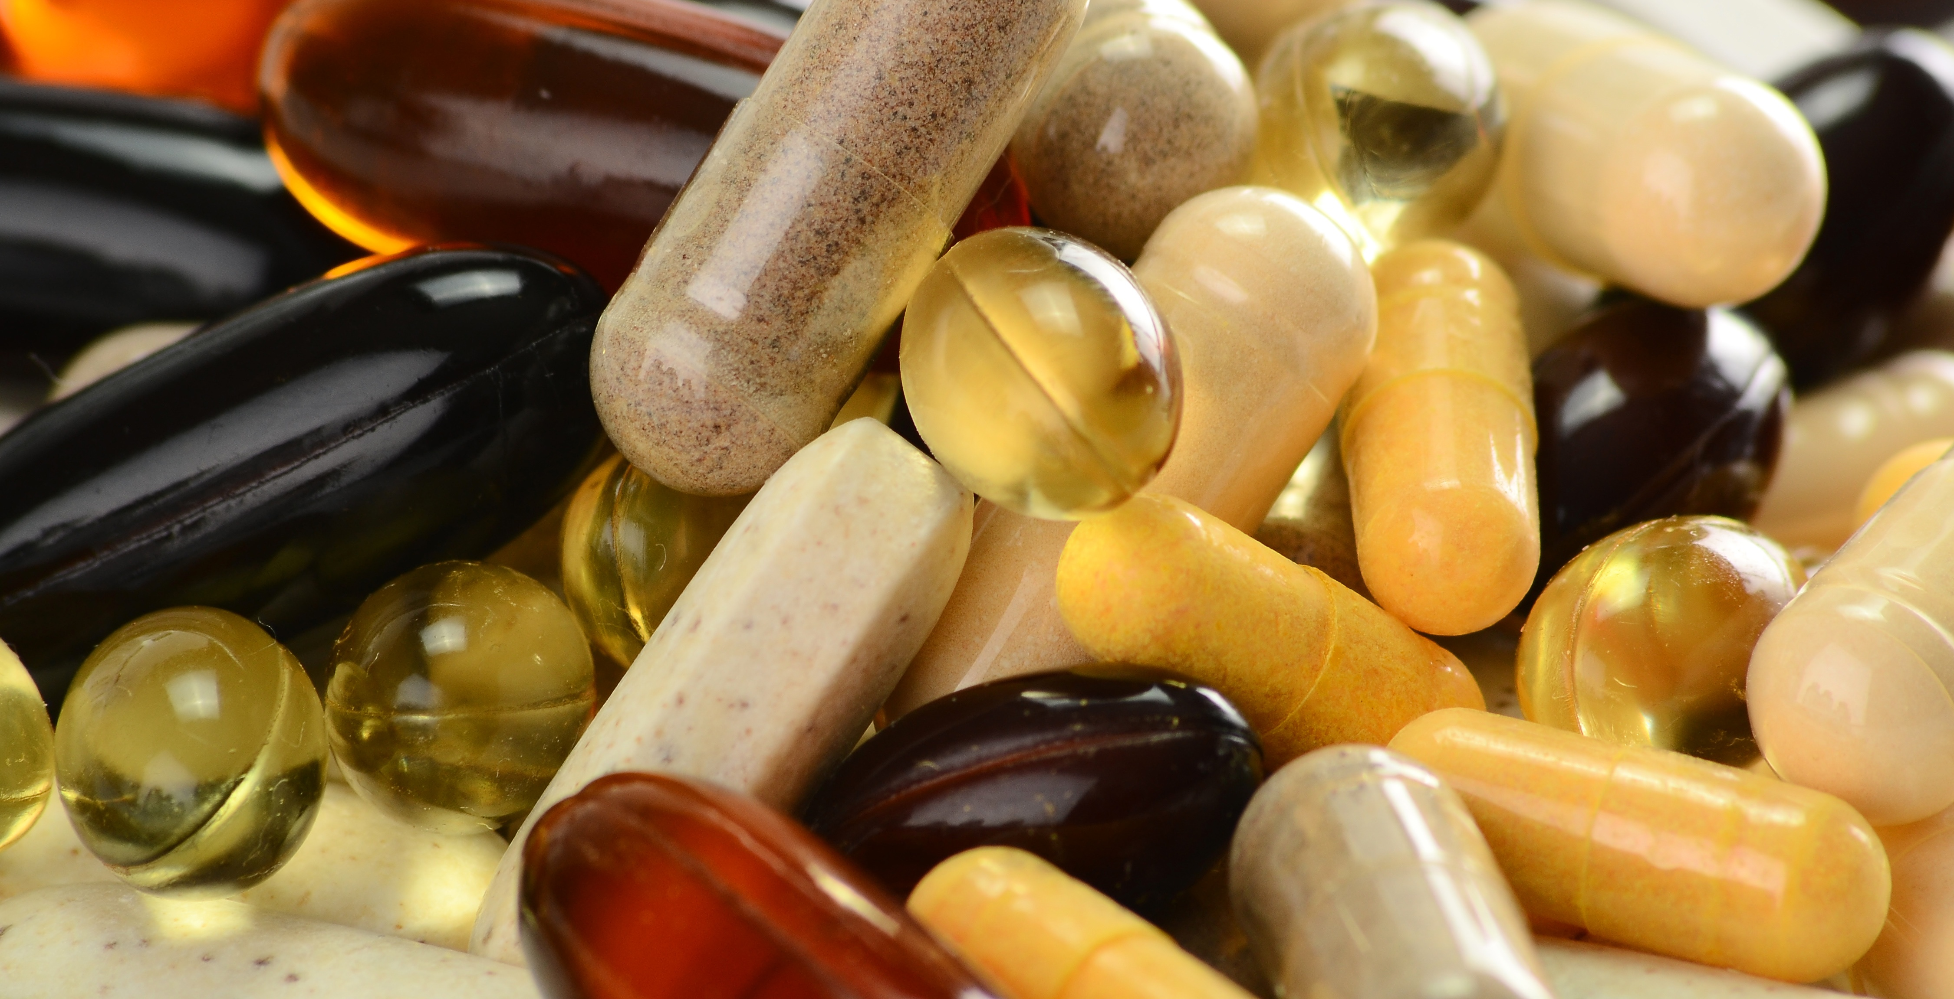
“Don’t take your vitamins”
FiveThirtyEight

Slide 4
<insert clickbait headline here…
(but don’t include any concrete information in the article)>

Slide 5
???

Slide 6
Millions of people can’t be wrong!

Slide 7
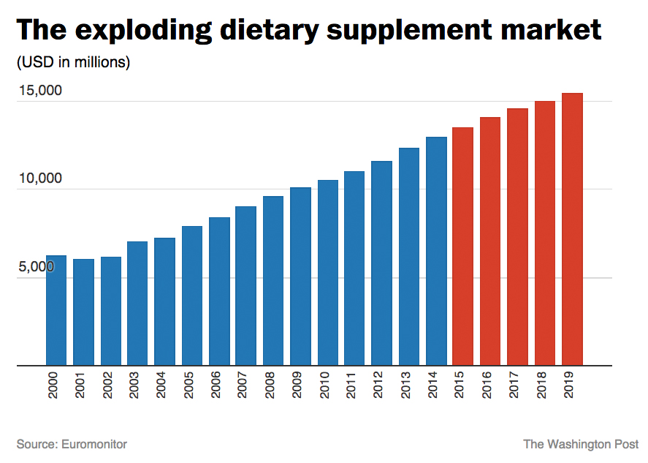

Slide 8

+$15,000,000,000 (by 2019)

Slide 9
Should we be so skeptical?

Slide 10
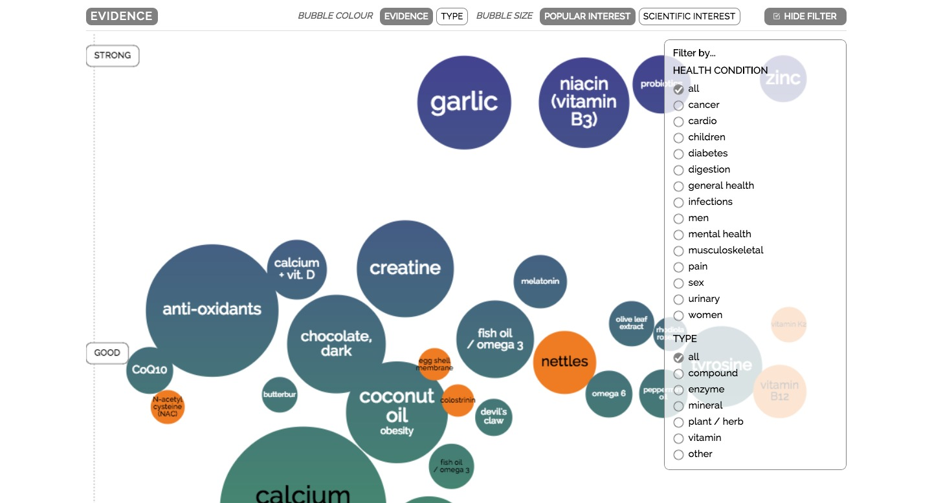
Research: Miriam Quick
Sources: PubMed, Cochrane.org, Examine.com
RCTs and population studies. Metastudies & large trials used where possible.

Slide 11
Maybe not…

Slide 12
…lets find out.

Slide 13
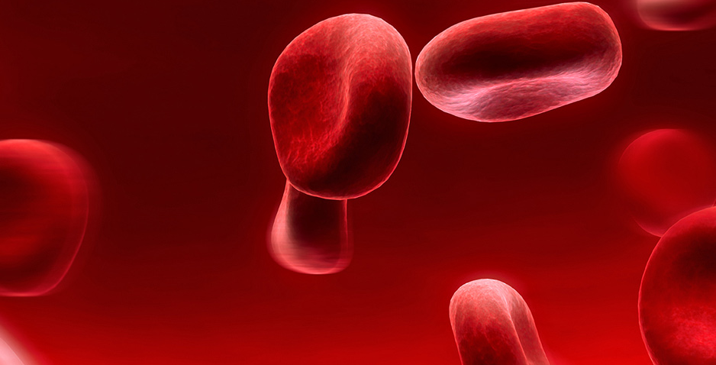
Hemavault
Home blood test kits for range of markers
Online results tracking
Science-based nutritional recommendations
Personalised supplements tailored to biology
Measure, track, improve

Slide 14
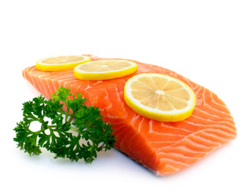
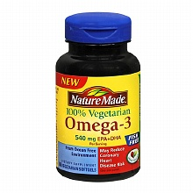
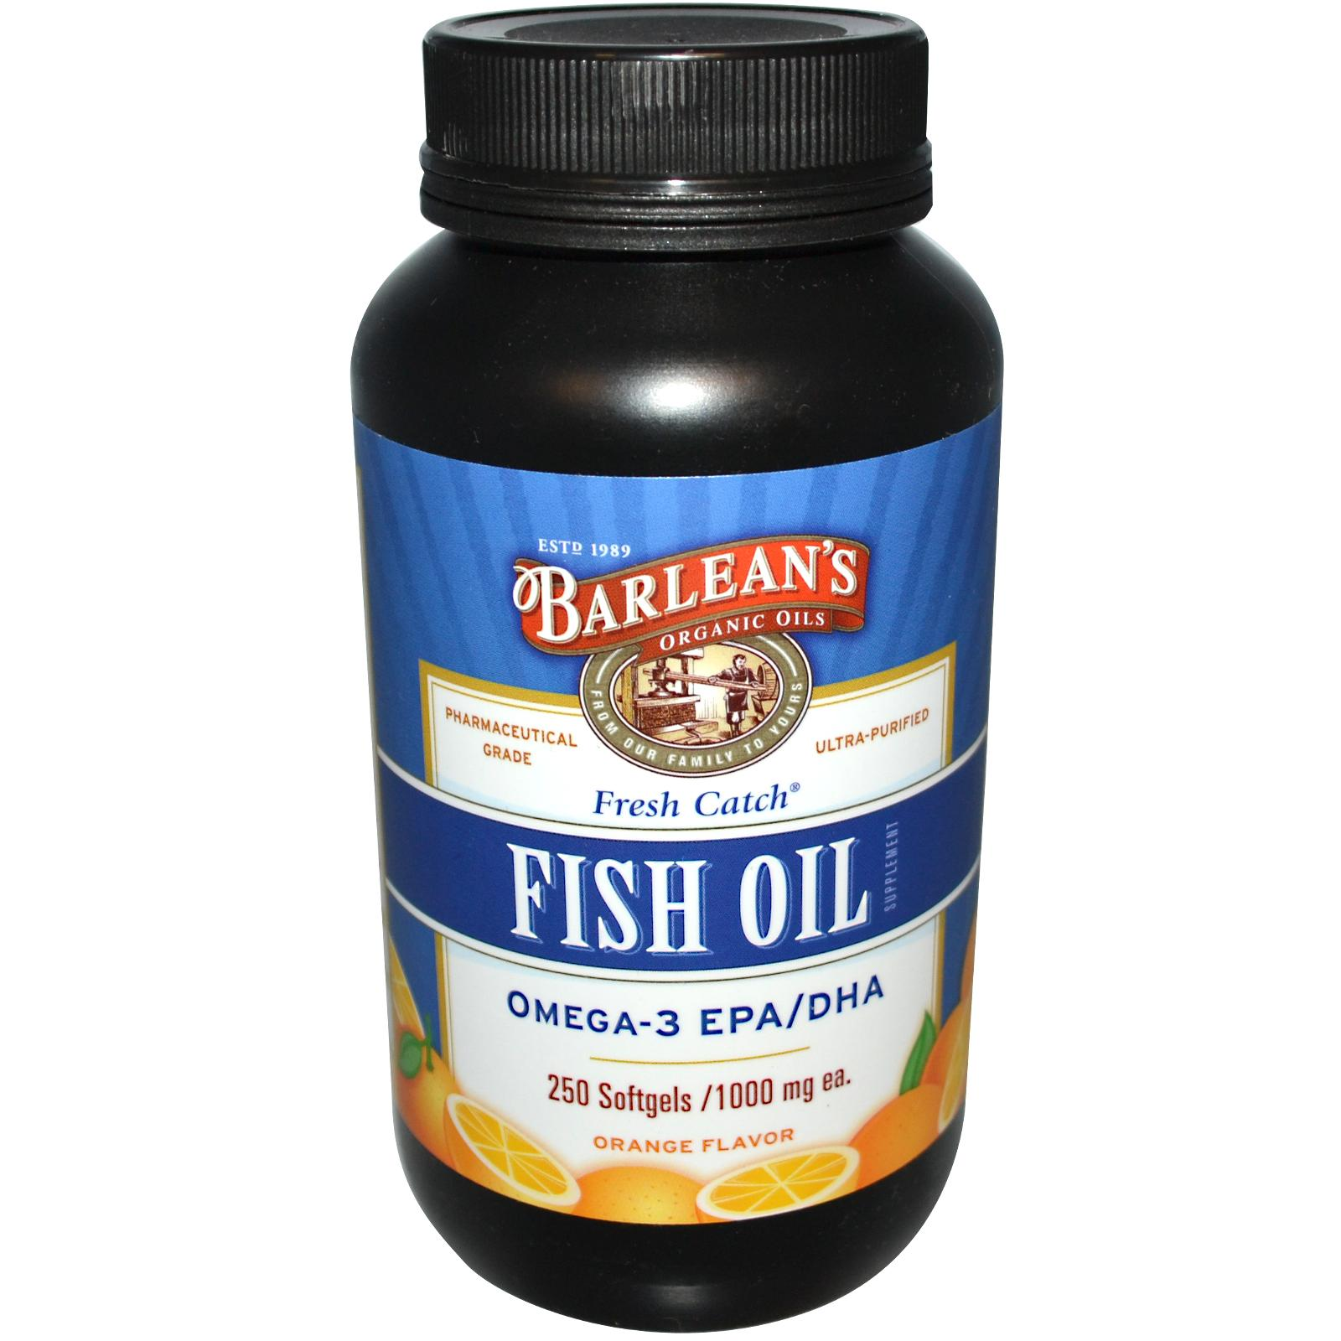
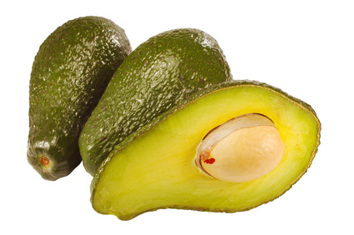
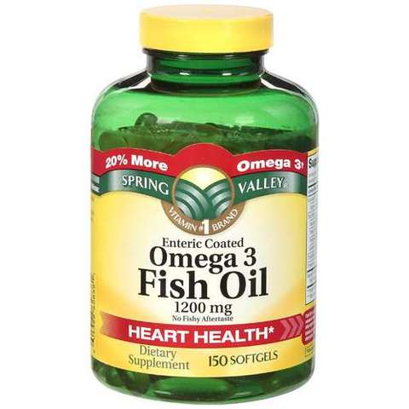
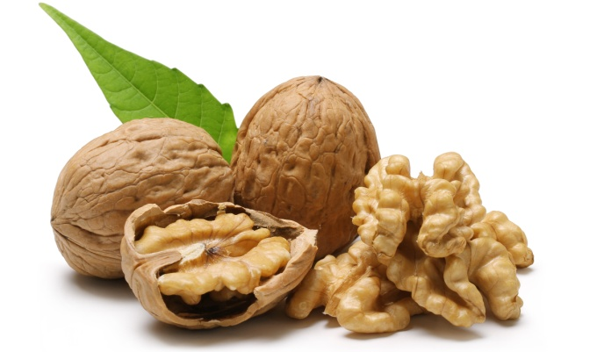
Omega-3

Slide 15
What is Omega-3?
Long-chain (eg. fish oils)
EPA (eicosapentaenoic acid)
DHA (docosahexaenoic acid)
Short-chain (eg. plant based)
ALA (alpha-linolenic acid)

Slide 16
Why Take Omega-3?
Research has shown:
good for your joints, skin, vision, brain, & heart
lowers bad cholesterol levels
anti-ageing
anti-inflammatory

Slide 17
Omega-3 Supplement Study
Over the counter supplements vs. Hemavault
Sample 20 people (10 per group)
not already taking supplements
50% male / 50% female
aged 24 - 66
Followed manufacturers dosage guidelines
Over 12 weeks, tested every month
Not controlled, needs much improvement

Slide 18
Holland & Barrett: Group Average
%FAME
date | avg. O3 (%FAME) | low ref | high ref | %inc
01/12/14 | 4.2 | 3.1 | 9.2
01/01/15 | 4.6 | 3.1 | 9.2 | 9.5
01/02/15 | 4.8 | 3.1 | 9.2 | 4.3
+~14%

Slide 19
Holland & Barrett: Initial Results
13/20 participants saw notable increase >+5%
7 participants saw no notable improvement -5% / +5%

Slide 20
Hemavault: Group Average
%FAME
date | avg. O3 (%FAME) | low ref | high ref | %inc
01/12/14 | 4 | 3.1 | 9.2
01/01/15 | 4.1 | 3.1 | 9.2 | 2.5
01/02/15 | 4.7 | 3.1 | 9.2 | 14.6
+~17%

Slide 21
Hemavault: Top Performer
%FAME
date | avg. O3 (%FAME) | low ref | high ref | %inc
01/12/14 | 2.5 | 3.1 | 9.2
01/01/15 | 3.4 | 3.1 | 9.2 | 36
01/02/15 | 4.2 | 3.1 | 9.2 | 23.53
+~36%
Female, 52 years

Slide 22
Hemavault: Initial Results
15/20 participants saw notable increase >+5%
5 participants saw no notable improvement -5% / +5%

Slide 23
Experiment: Expectations
Food = best source
other good nutrients, such as protein, vitamins and minerals.
Some supplements more effective than others
bio-individuality
quality
More effective for those with existing deficiency
More effective for people > 45 years

Slide 24
We need your help to find out!

Slide 25
hema.vu/qsmeetup
www.hemavault.com / @hemavault

